Slide 1

F
r
F
e
e
d
a
m
By
VEDANT PANDURANG DIVATE –MS2503
SANIKA NIVAS MAHIND -MS2517
PANKAJ Rajebdra JADHAV -MS2509
Guide
Ichchyakant Sharma sir
Department of Scientific Computing Modeling and Simulation
Savitribai Phule Pune University,Pune
Date: 4 November 2025

Slide 2
Introduction
AgriFert is a web-based platform designed for farmers and gardeners to buy fertilizers easily from one place.
It provides details of various fertilizers, their prices, and helps users place online orders quickly.

Slide 3
Problem Statement
Farmers face problems finding the right fertilizers at the right time.
Many have to travel long distances on local shops.
There is no simple online system to view, compare, and order fertilizers.

Slide 4
Objective
To provide clear product details and prices.
To help farmers save time by ordering from home.
To manage fertilizer information and orders digitally
.

Slide 6
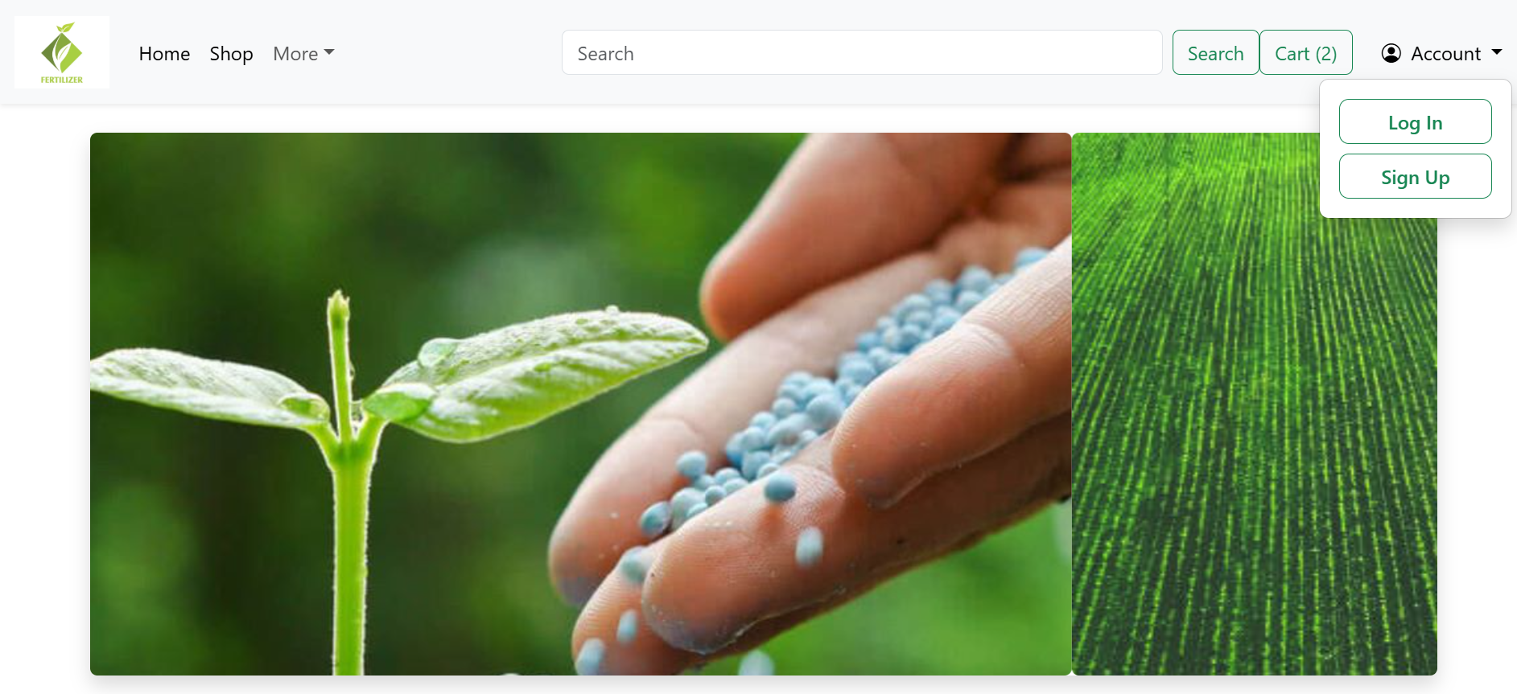
Proposed Solution
AgriFert offers an online solution where:
Users can browse fertilizers by type and price.
Add them to cart and order online.
Admin can manage fertilizer details, prices, and orders.

Slide 7





Technologies Used
Frontend:
Backend: Java,Springboot
Database:

Slide 8
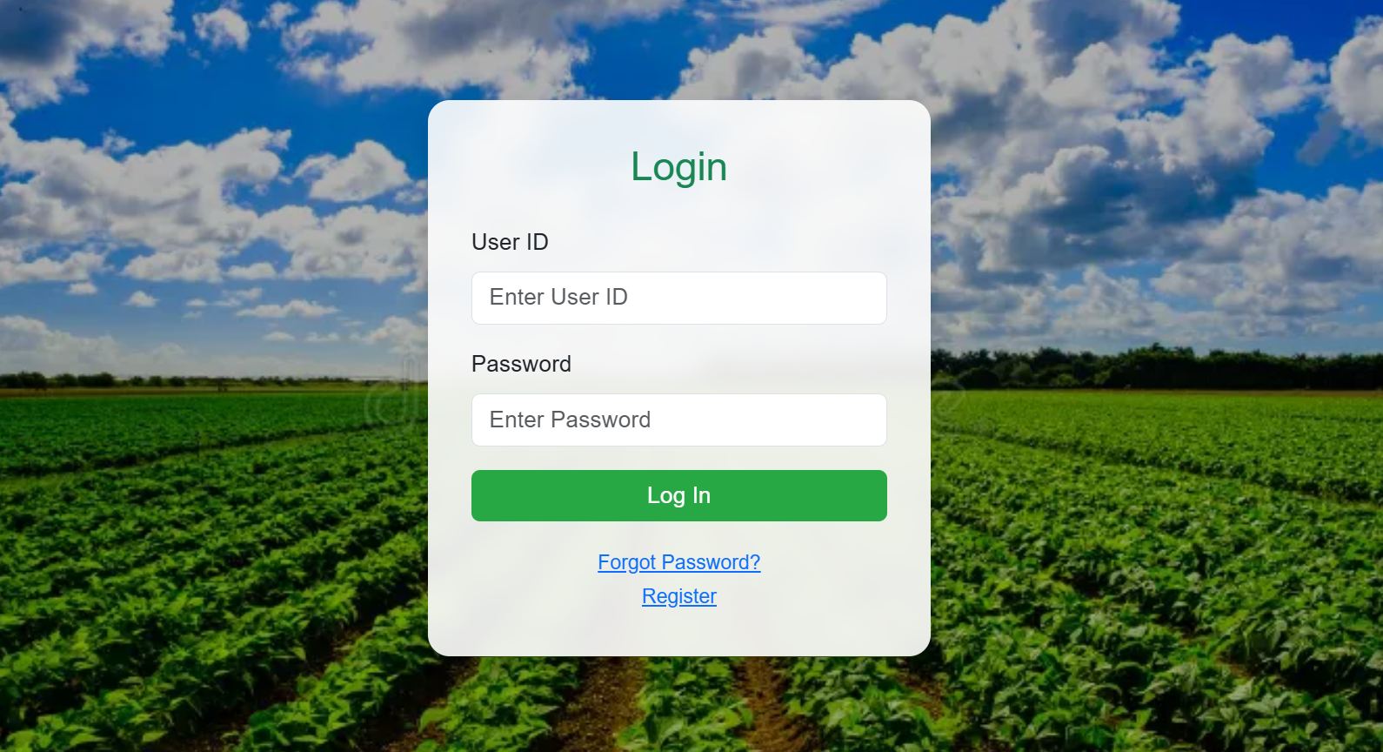
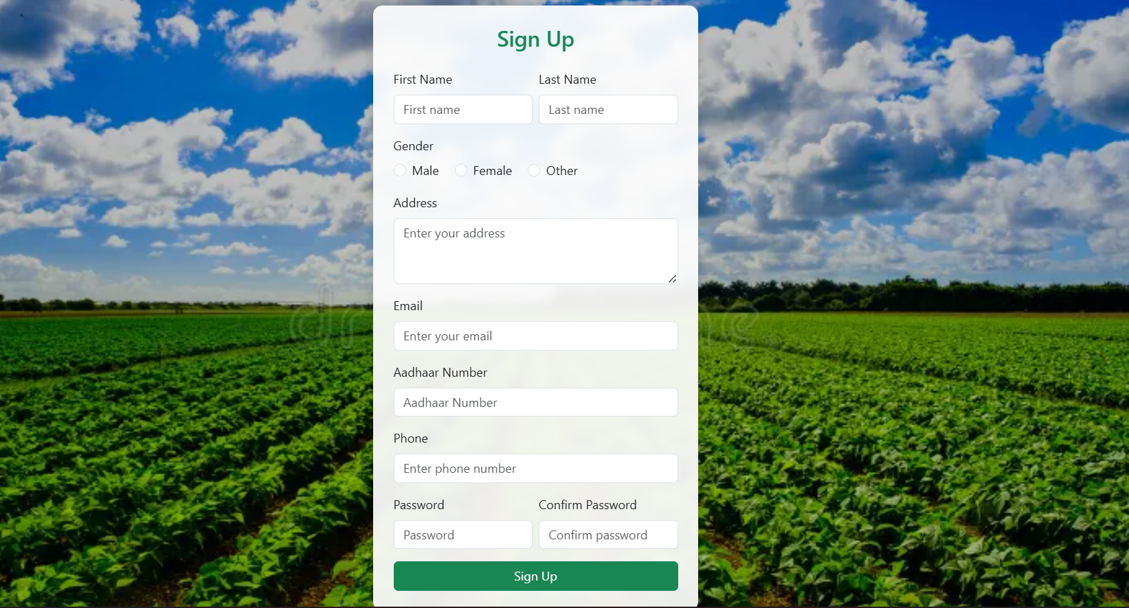
System Modules
User Module:
Register(Sign UP)
Login
Browse Fertilizers
Add to Cart

Slide 9
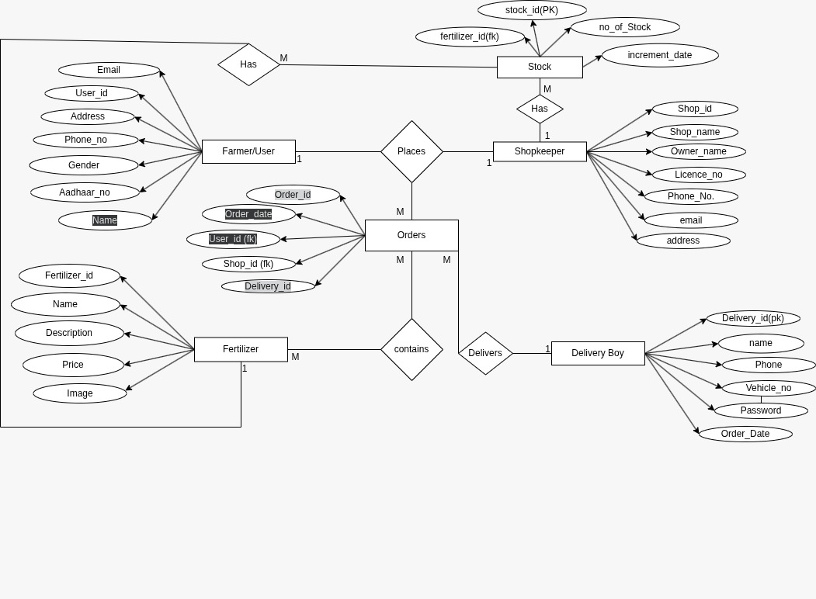
Database Design
Users – Stores user login details
Fertilizers – Contains product info, price, and image
Orders – Stores customer orders
Cart – Temporary storage for selected items

Slide 10
Conclusion & Future Work
Conclusion:
AgriFert helps farmers order fertilizers easily and manage their purchases online.
Future Enhancements:
Online Payment Integration
Order Tracking
Delivery Partner Module
Admin Module

Slide 11
Thank You…!

